Slide 1


Capstone project phase B Dealing with communication and concentration disorders 23-2-D-23
Capstone Project Phase 2
Supervisor :
Dr.Natali Levi
Authors :
Daniel Tau
Karin Azulay Shokrany

Slide 2

Roadmap
Our Solution
The Product
Main Features
Verification
Demonstration
Conclusions
Introduction

Slide 3
Background: ADHD in the classroom
ADHD in the classroom: Pupils with ADHD face challenges in attention, hyperactivity, and impulsivity, affecting their learning and interactions.
Classroom struggles: ADHD symptoms disrupt concentration, organization, behavior, impacting academic progress and classroom dynamics.
Meeting pupils needs: Enhancing ADHD awareness, tailored treatments, and effective management tools support pupil success in the classroom.

Slide 4
Introduction: Bridging the gap in Awareness and Empowering Effective Management
Common yet misunderstood: ADHD affects many, but educators often lack awareness.
Lack of pupil ADHD management tools.
Personalized treatment plans: most treatments are medicine based or common treatment options.

Slide 5
Our solution – OPM & Research
Introducing our ADHD management app, designed specifically for educators. With our app, teachers gain access to a comprehensive platform for managing pupils with ADHD. Utilizing a user-friendly form, teachers can gather essential information to generate personalized treatment options.

Slide 6
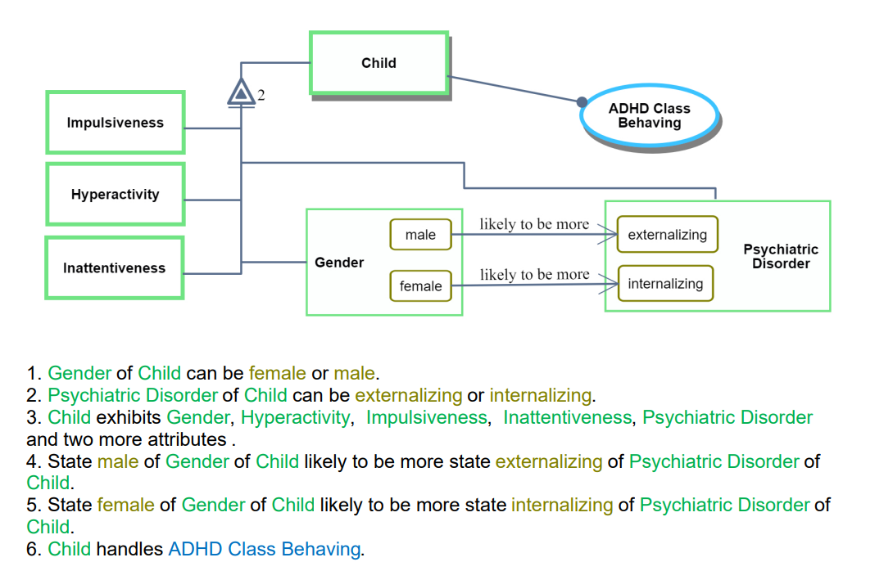
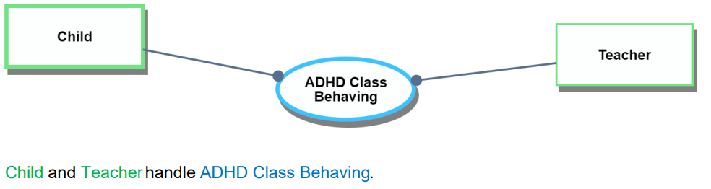
Our solution – OPM & Research
The Form & Treatment plan is based on both the OPM model created by us And the supervisor, and extensive research during phase A.

Slide 7
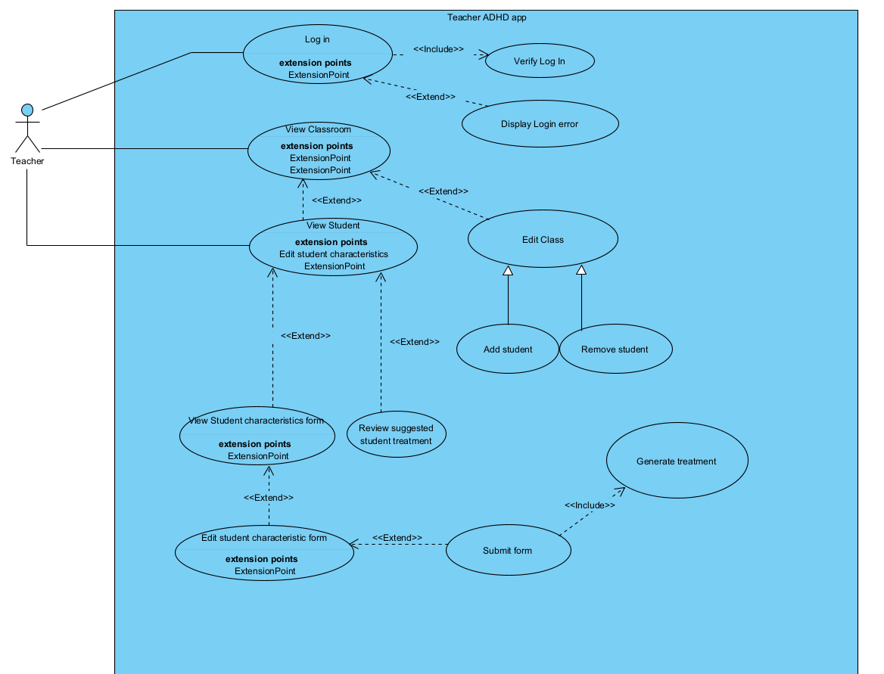
The Product: Use-Case diagram

Slide 8
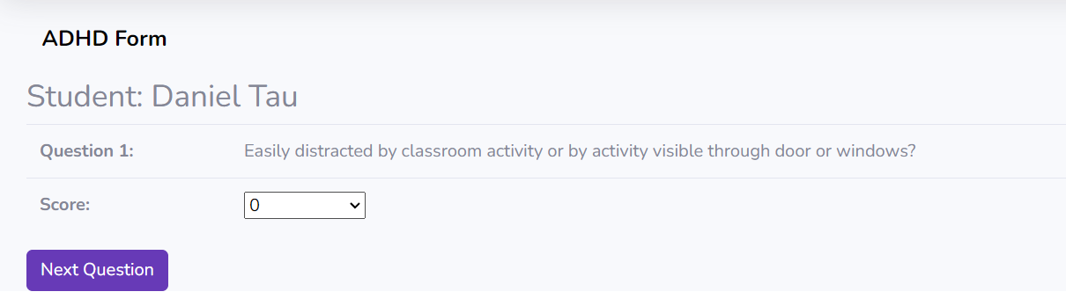
Main Features: The ADHD form
Quick access to the ADHD form from almost anywhere in the app!
Changed your mind? Want to edit existing Plan? Want to delete the form? We have you supported for all those operations!
Customized questions: the form is diverse and features many questions in unrelated order to not affect any of the teacher decisions.
Want to select a specific pupil? Or maybe a pupil from a chosen classroom? We have both options covered!

Slide 9
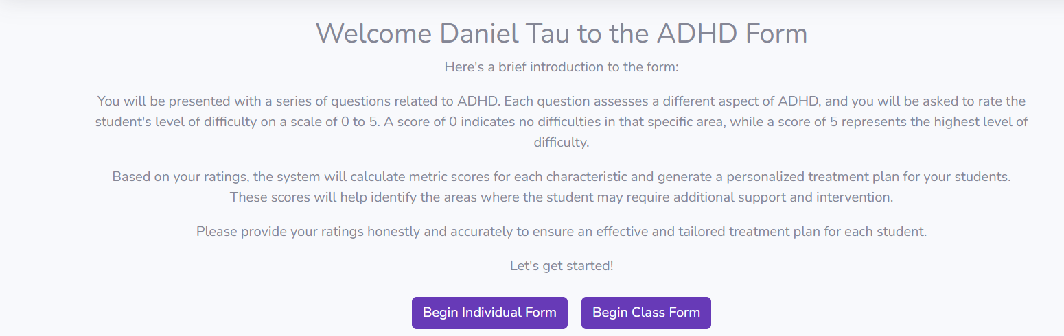
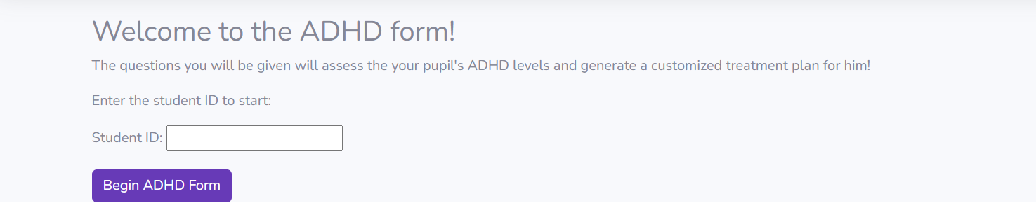
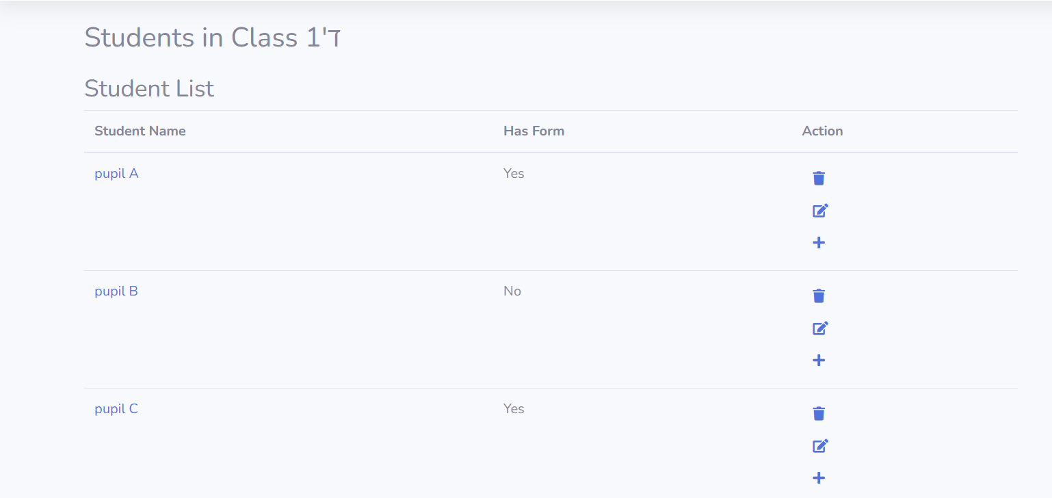
Main Features: ADHD form

Slide 10
Main Features: The Treatment plan
Based on real elementary school requirements!
Customized and diverse treatment plan based on every question answered in the form.
Availability to focus on a singular treatment plan, or a treatment plan for the entire classroom!
Sorted display from the most urgent treatment options to the least urgent!

Slide 11
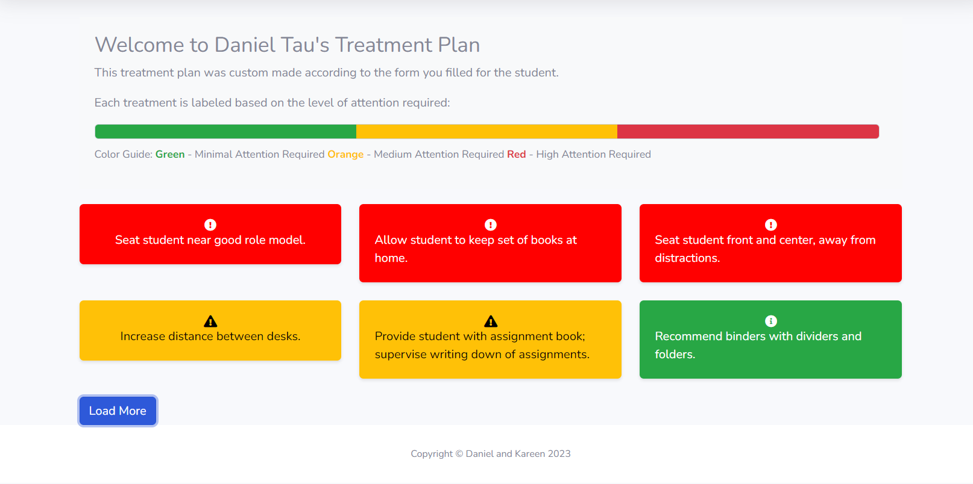
Main Features: ADHD Treatment Plan

Slide 12
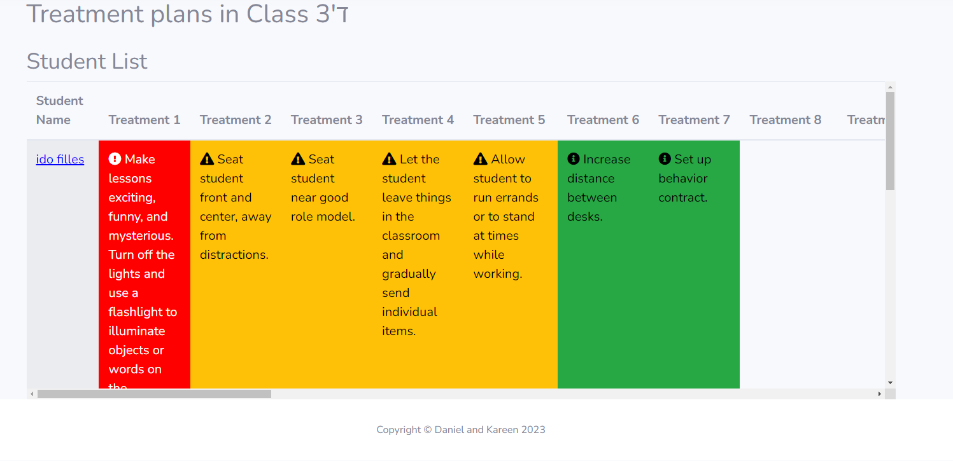
Main Features: ADHD Treatment Plan

Slide 13
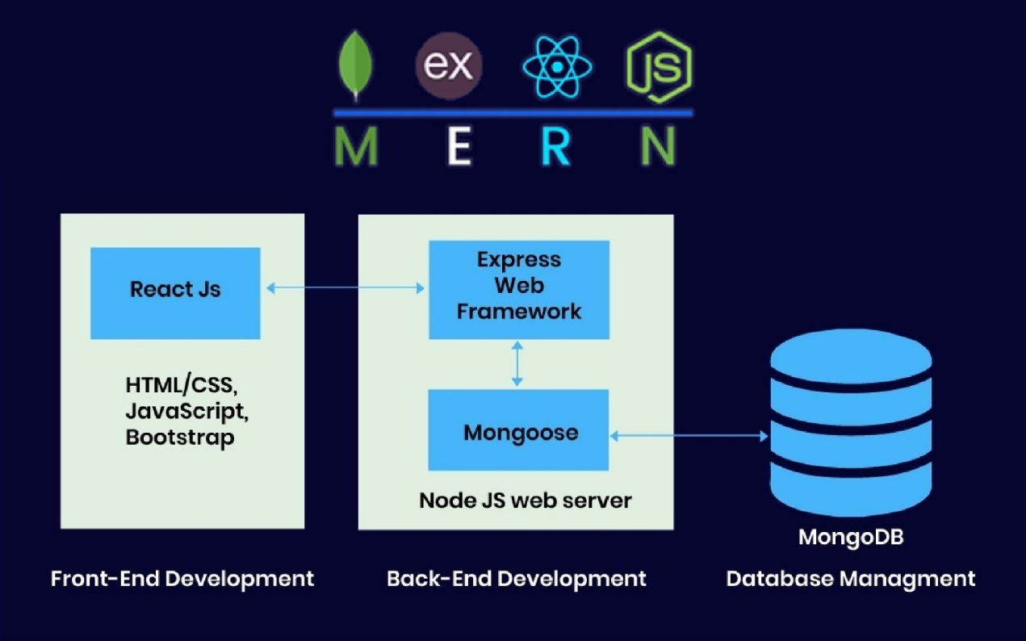
Architecture

Slide 14

Software infrastructure
These are the main modules used in our project.
The rest may be found in the package-lock.json on our github!
NodeJS version 18.16.0
MongoDB version 5.6.0
ExpressJS version 4.18.2
EJS version: 3.1.9

Slide 15
Verification
In order to test our system, we performed two kinds of evaluation tests. The first one is unit testing and the second is functional testing.
The tests performed were based on the evaluation plan from phase A.
The application was sent to a school for review which will give back feedback in July due to end of year workload.

Slide 16
Verification – Unit Testing
Add Class
No. | Test Subject | Expected result | Result
12 | Class name already exists | “Class name already exists" display on screen. | Pass
Add Form
No. | Test Subject | Expected result | Result
13 | Enter student ID with existing form | “A form already exists for this student. Do you want to edit or delete the existing form?" display on screen. | Pass
14 | Enter invalid student ID | “Student not found. Please enter a valid student ID." display on screen. | Pass
15 | Enter class with no students | “No students found for the selected class. Please choose another class.” display on screen | Pass
Add student
No. | Test Subject | Expected result | Result
10 | Enter student ID shorter/longer then 9 digits | "Please match the requested format" display on screen. | Pass
11 | Enter existing student ID | "Student with the same ID already exists." display on screen. | Pass

Slide 17
Verification – Functionality Testing
Display class form
No. | Test Subject | Expected result | Result
13 | The teacher chooses a student to begin form for | The form is displayed. | Pass
14 | The teacher chooses a student to edit form for | The previous form filled is displayed. | Pass
15 | The teacher chooses a student to remove a form for | The chosen student form is removed. | Pass
16 | The teacher presses Next/Previous Students | Next/Previous set of 3 students is displayed. | Pass
Displayed Form
No. | Test Subject | Expected result | Result
17 | The teacher presses ‘next/previous question’ | Next/Previous question is displayed. | Pass
18 | The teacher chooses Submit Form | The form is submitted, and a treatment plan is generated. | Pass

Slide 18
Verification – Functionality Testing
Treatment
No. | Test Subject | Expected result | Result
19 | The teacher enters ‘Student Treatment’ | The Student Treatment introduction page is displayed. | Pass
20 | The teacher enters ‘Class Treatment’ | The Class Treatment introduction page is displayed. | Pass
Student Treatment
No. | Test Subject | Expected result | Result
21 | The teacher enters a valid student ID with existing form | The student treatment plan is displayed. | Pass
Class Treatment
No. | Test Subject | Expected result | Result
22 | The teacher chooses a none empty classroom | The Treatment for all students in the chosen classroom is displayed. | Pass
23 | The teacher presses on a student name | The chosen student treatment plan is displayed. | Pass
Student Treatment Display
No. | Test Subject | Expected result | Result
24 | The teacher presses ‘Load More’ | The next treatment option pops up. | Pass

Slide 19
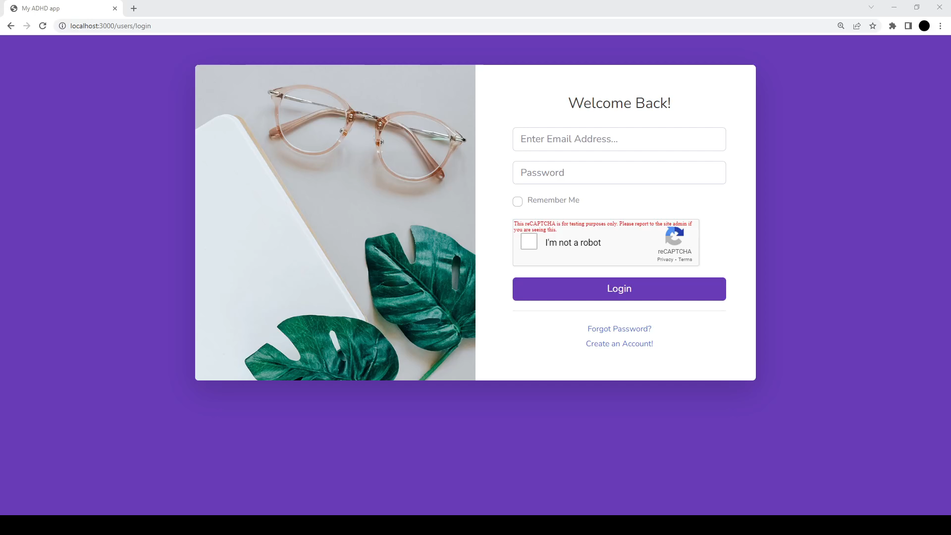
Demonstration

Slide 20
Challenges & Conclusions
01
Develop a user-friendly, cross-platform application that can operate on a wide range of platforms
Work with new languages and technologies - NodeJS, React, Express.
02
Work with new languages and technologies - NodeJS, MongoDB, Express.
03
Deploy the app to be accessed from anywhere.
Elementary school availability for receiving feedback on the web-application.
04

Slide 21
References
Want to visit us? Check us out at: https://adhd-web-app.onrender.com/
Interested in the code? Want to run it on your local machine? Check out at https://github.com/DanielTau94
OPM pictures from our supervisor Dr Natali Levi.

Slide 22
THANKS!
Any questions?

